Slide 1
SMART FASHION RECOMMENDER SYSTEM
CLOUD APPLICATION DEVELOPMENT

Slide 2
TEAM ID-PNT2022TMID39615
TEAM MEMBERS
1.SUSMITHA S G - 510619104073
2. MOHANA PRIYA V - 510619104050
3. HINITA PRIYANKA S - 510619104026
4.SIVA PRIYA T - 510619104065
5.PRIYADHARSHINI S - 510619104054

Slide 3
PROJECT OVERVIEW
Humans are inevitably drawn towards something that is visually more attractive. This tendency of humans has led to development of fashion industry over the course of time. With introduction of recommender systems in multiple domains, retail industries are coming forward with investments in latest technology to improve their business. Fashion has been in existence since centuries and will be prevalent in the coming days as well. Women are more correlated with fashion and style, and they have a larger product base to deal with making it difficult to take decisions. It has become an important aspect of life for modern families since a person is more often than not judged based on his attire. Moreover, apparel providers need their customers to explore their entire product line so they can choose what they like the most which is not possible by simply going into a cloth store. With the increasing amount of information that people browse daily, how to quickly obtain Information Items that meet people’s needs has become an urgent issue these days. The effort in information retrieval have brought great convenience to people who tend to retrieve information by entering a query or keywords. If some information-intensive websites can proactively suggest products or information items that users may be interested in, it will greatly improve the efficiency and satisfaction of users in obtaining information items. The research in the field of recommender systems precisely originated on this subject. Over the past years, tremendous progress has been made into this area, from non-personalised to personalised and to more recent deep learning recommender systems. This report reviews some existing well-established recommender systems and investigate some existing metrics for evaluating them. Besides, this report gives details of the project’s implementation - a web application for the offline evaluation of three major collaborative filtering recommendation algorithms, item-based, user-based, and matrix factorisation. The project aims to provide a comprehensive platform for designers to evaluate recommender systems and guide them to design better recommender systems
The application supports a wide range of readily configurable evaluation metrics for users to visualise the performance between different recommendation algorithms.

Slide 4
PURPOSE
The purpose is another important dimension to describe recommender systems.
The purpose can be defined as the goals for which a recommender system is being used. The purpose can be the further study in recommendation algorithms for researchers, or online testing for evaluators, or simply the retrieval of relevant information for internet users. Understanding for the purpose is often important in real marketing because the purpose of users and information providers can sometimes be different. For instance, the users may be more interested in receiving high-quality recommendations, while the providers are more willing to suggest particular items or products to increase the revenue. That says the purpose guides the recommender employers to be on the right track. In it is emphasized that, in order to properly evaluate a recommender system, it is important to understand the user purpose. The paper points out that a comprehensive consideration for user goals makes it more sensible to decide what evaluation metrics are chosen to measure the quality of recommender systems.

Slide 5
PROBLEM STATEMENT
The personal information collected by recommenders raises the risk of unwanted exposure of that information. Also, malicious users can bias or sabotage the recommendations that are provided to other users . In recent years, the textile and fashion industries have witnessed an enormous amount of growth in fast fashion. On e-commerce platforms, where numerous choices are available, an efficient recommendation system is required to sort, order, and efficiently convey relevant product content or information to users.

Slide 6
LITERATURE REVIEW
EXISTING SYSTEM
In existing system only simple web application and their rating has been implemented in existing system, An ecommerce product recommendation engine is a piece of technology that displays recommended products to shoppers throughout your store. It uses machine learning to get smarter and show increasingly relevant products to shoppers based on their interests and previous browsing behaviour .An existing model is content based filtering scheme has been employed in existing model The content-based filtering method analyses customer data on the likes and dislikes of each user (cookies allow tracking over multiple visits), then makes recommendations based on the browsing history of that user. The idea behind content-based filtering is that if you enjoy a certain item, you’ll likely also enjoy a similar item.

Slide 7
TECHNOLOGIES USED
SOFTWARE REQUIREMENTS
HARDWARE REQUIREMENTS
Operating system : Windows(any version)
Technologies : Dockers , Kubernetes .
Services used : IBM cloud service
Browsers :Chrome, Internet explorer, Firefox, etc
Languages :
Front End: HTML , CSS , JavaScript
Back End: Python
Database: SQL
RAM :4GB
Hard disk :64 GB
Internet access requirement

Slide 8
SOLUTION ARCHITECTURE
INTERNET
SERVICE
PROVIDER
MOBILE
USERS
BROWSER
INTERNET
ACCESS
SERVICE
RECORD
HISTORY
PROFILE
SERVICE
SP
GENERATOR
-
DATA
PROFILE
LOCATI
O
N
RECOMMENDATION GENERATOR(ON
MANAGER
LINE)
-

Slide 9
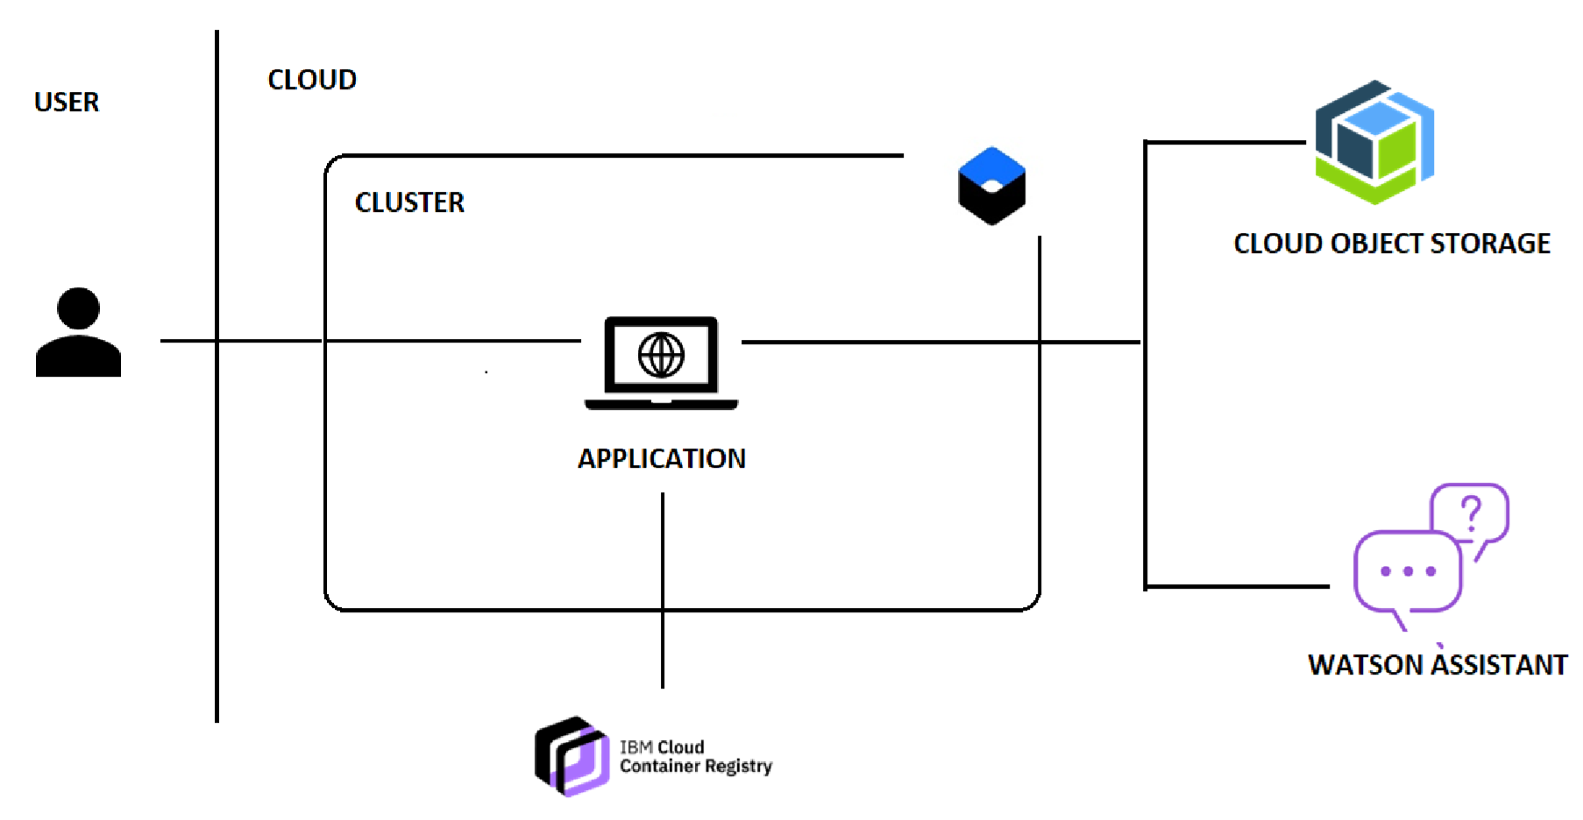
TECHNICAL ARCHITECHTURE

Slide 10
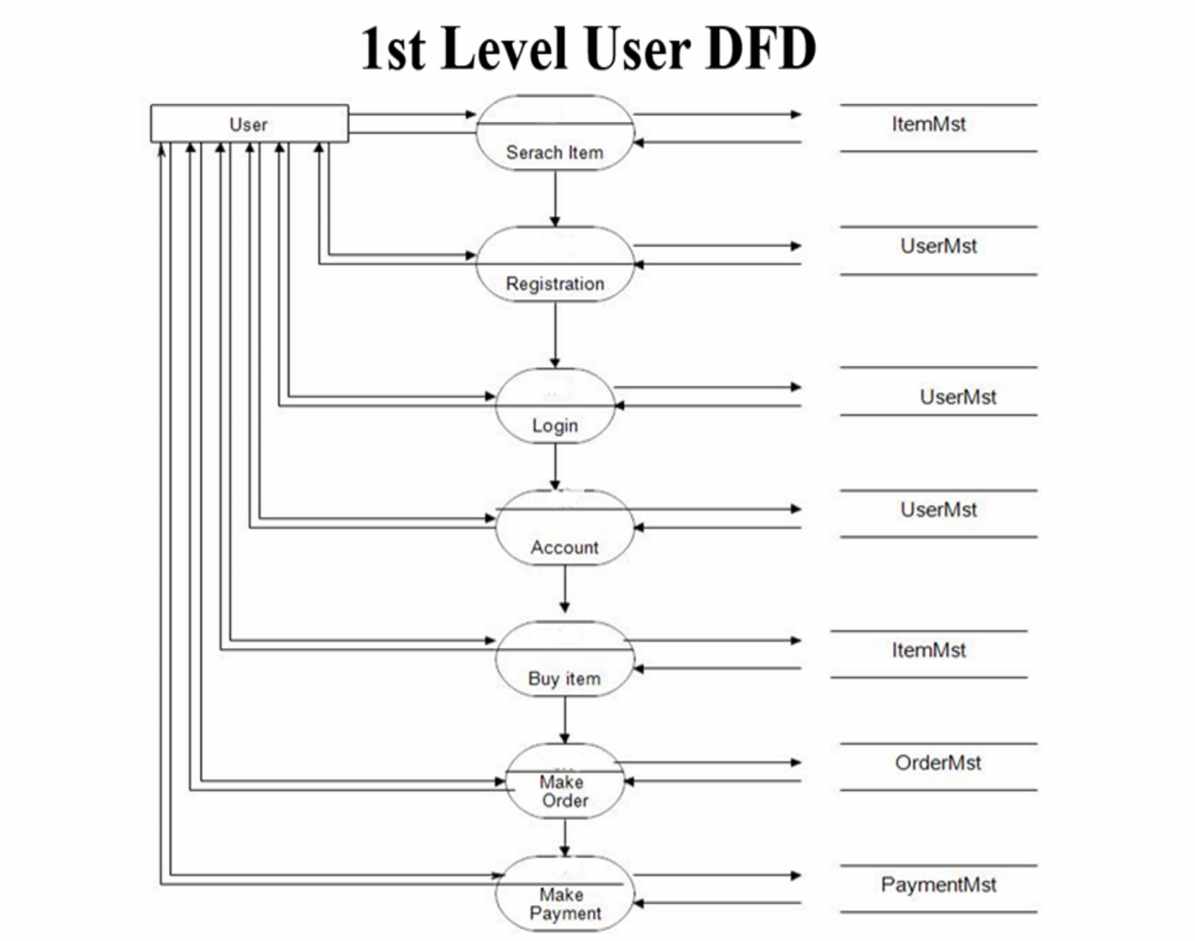
DFD LEVEL 1 DIAGRAM

Slide 11
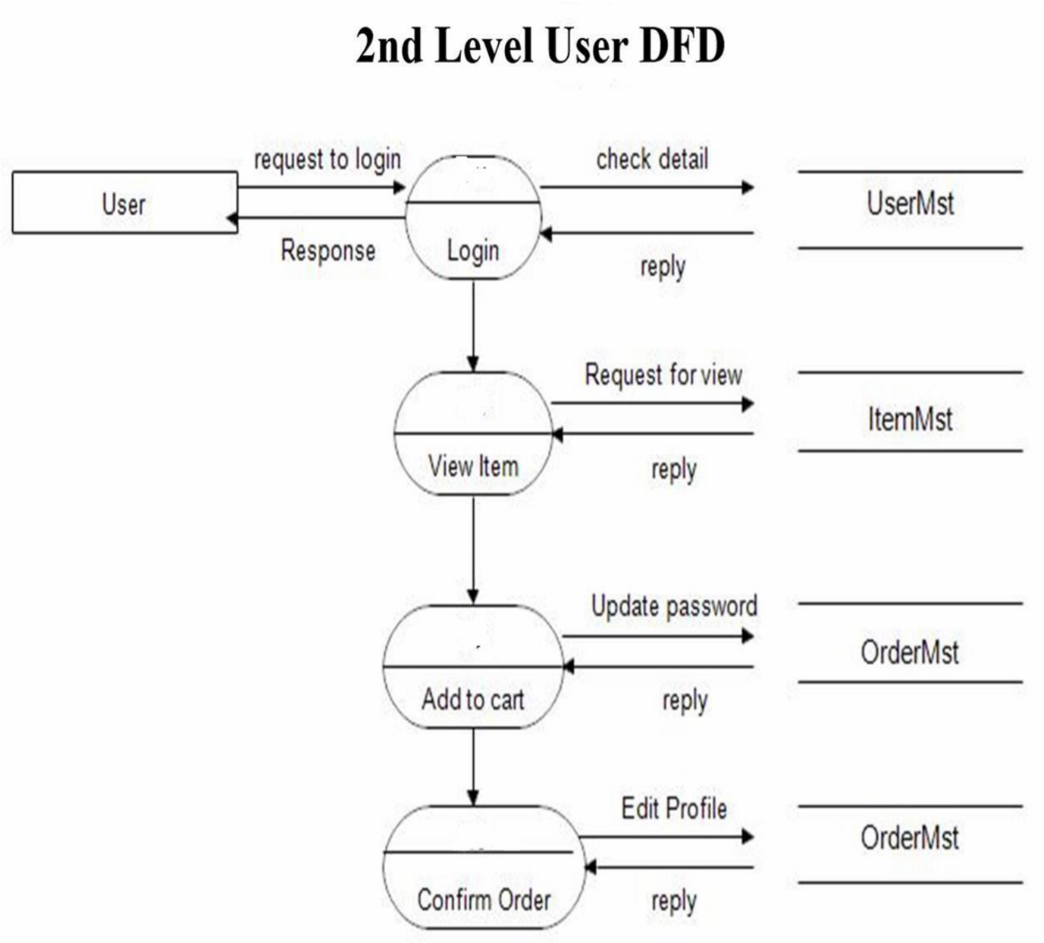
DFD LEVEL 2 DIAGRAM

Slide 12
FUNCTIONAL REQUIREMENTS
FR No. | Functional Requirement (Epic) | Sub Requirement (Story / Sub-Task)
FR-1 | User Registration | Registration through Form Registration through Gmail
FR-2 | User Confirmation | Confirmation via Email Confirmation via OTP
FR-3 | Product Master | It includes the information of the products, item no, size, categories etc.
FR-4 | Mobile Friendliness | An analytic tool to study the audience and inquire about their devices. Know the position of essential buttons and options on the webpages, change them accordingly for a better experience.
FR-5 | Price Master | Only for the price of the products and applicable discount of the products.
FR-6 | Transaction | It is a payment method in which the transfer of money of buying products. This process is secure and password protected.
FR-7 | Reporting | After ordering for the product, the system will send one copy of the bill to the customer’s Email-address and another one for the system data base.
FR-8 | Delivery Report | List of the products that can be delivered to the customer.
FR-9 | Changes to cart | Changes to cart means the customer after login or registration can make order or cancel order of the product from the shopping cart.
FR-10 | Payment | In this system we are dealing the mode of payment by cash. We will extend this to credit card, debit card etc. in the future.
FR-11 | Interface aspects | Simulates and processes human conversation (either spoken or written), allowing humans to interact with digital devices as if they were communicating with a real person.
FR-12 | Logout | After ordering or surfing for the product customer has to logout.

Slide 13
NON-FUNCTIONAL REQUIREMENTS
FR No. | Non-Functional Requirement | Description
NFR-1 | Usability | Usability encapsulates the user experience. Essentially, it means the ease with which a visitor to the site can interact with it. If a site has strong usability, it provides an experience that is more comfortable and straightforward for its users to navigate.
NFR-2 | Security | Security comes with utmost importance if a site is dealing with monetary transactions, users’ financial and sensitive data. Privacy – The control over one's personal data. Security – The attempted access to data by unauthorized others.
NFR-3 | Maintainability | Thriving the website maintenance from the initial development means cutting the time & cost to determine and resolve the faults of the system in the future
NFR-4 | Performance | The focus is on loading the e-commerce store as fast as possible regardless of the number of integrations and traffic on the website.
NFR-5 | Availability | It’s available for 24x7 hours and in any browsers.
NFR-6 | Scalability | It will define how the website can grow and increase its features and functionality without impacting the performance of the website.

Slide 14
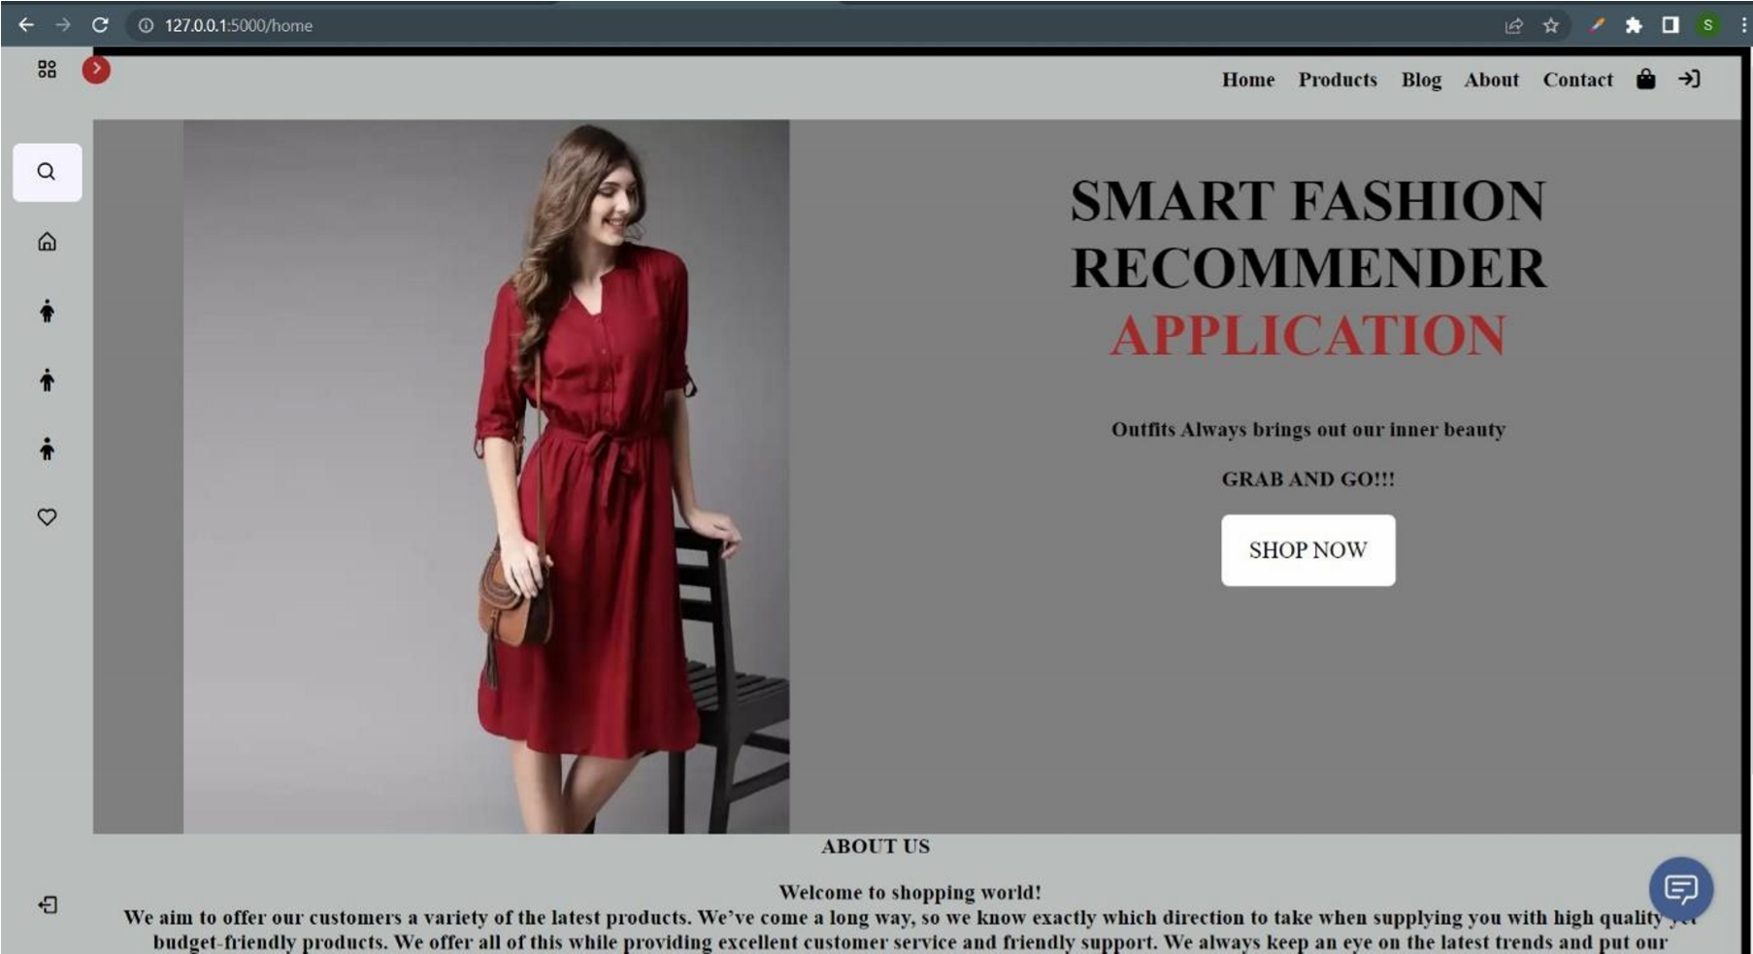
OUTPUT
HOME PAGE

Slide 15
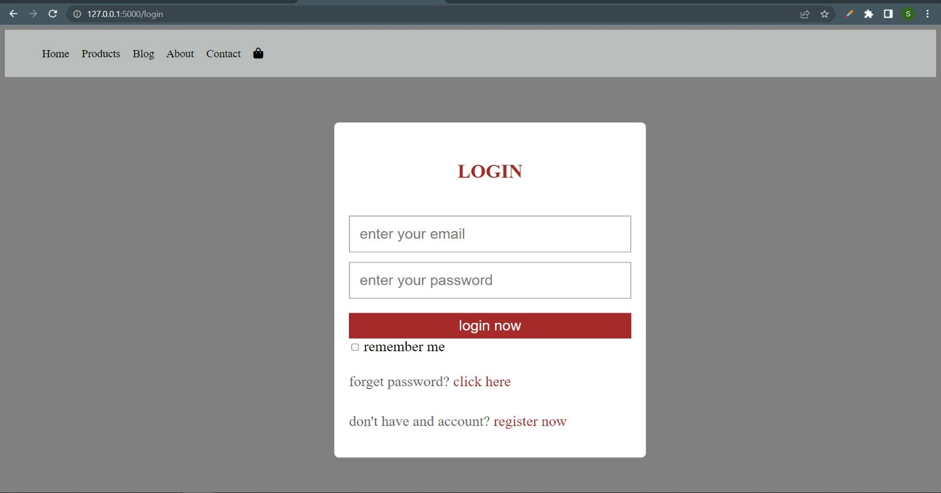
LOGIN PAGE

Slide 16
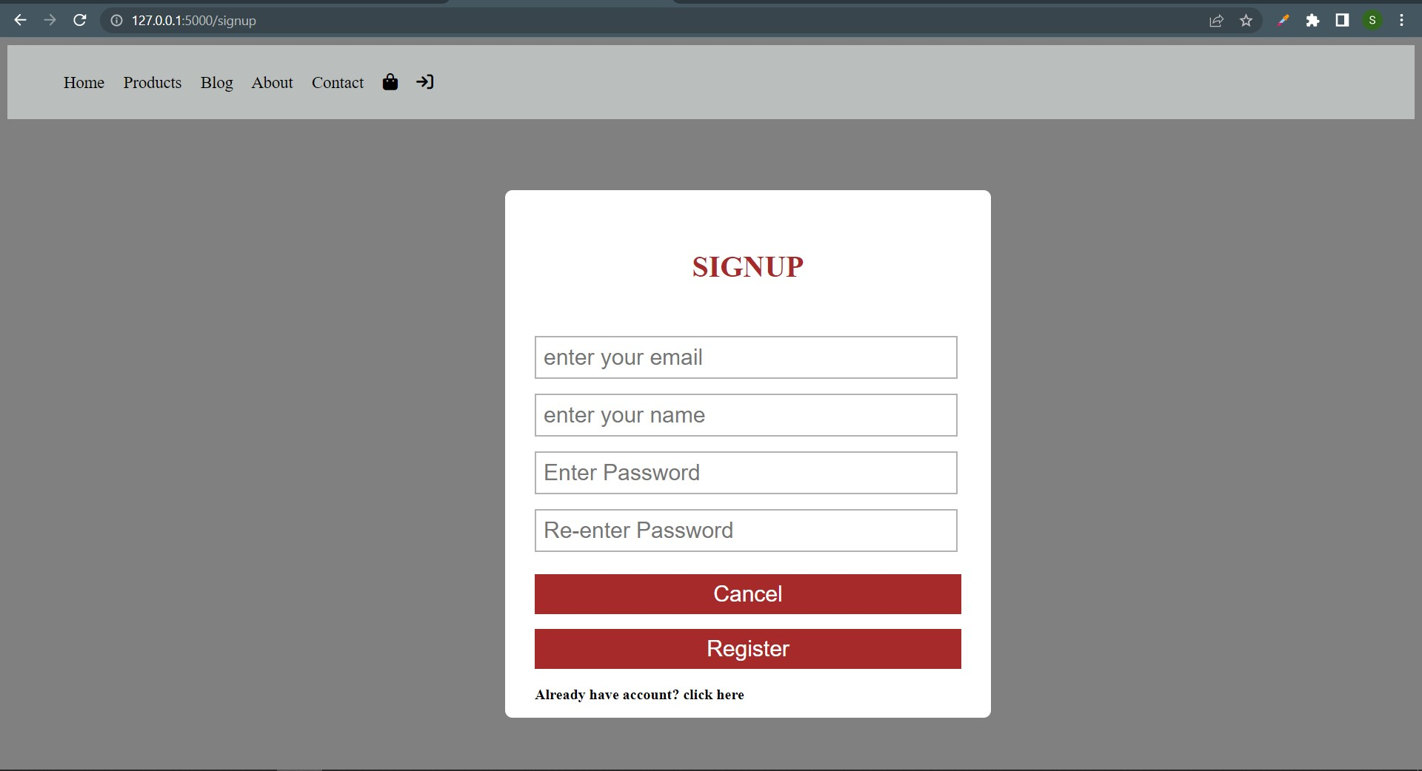
SIGN UP PAGE

Slide 17
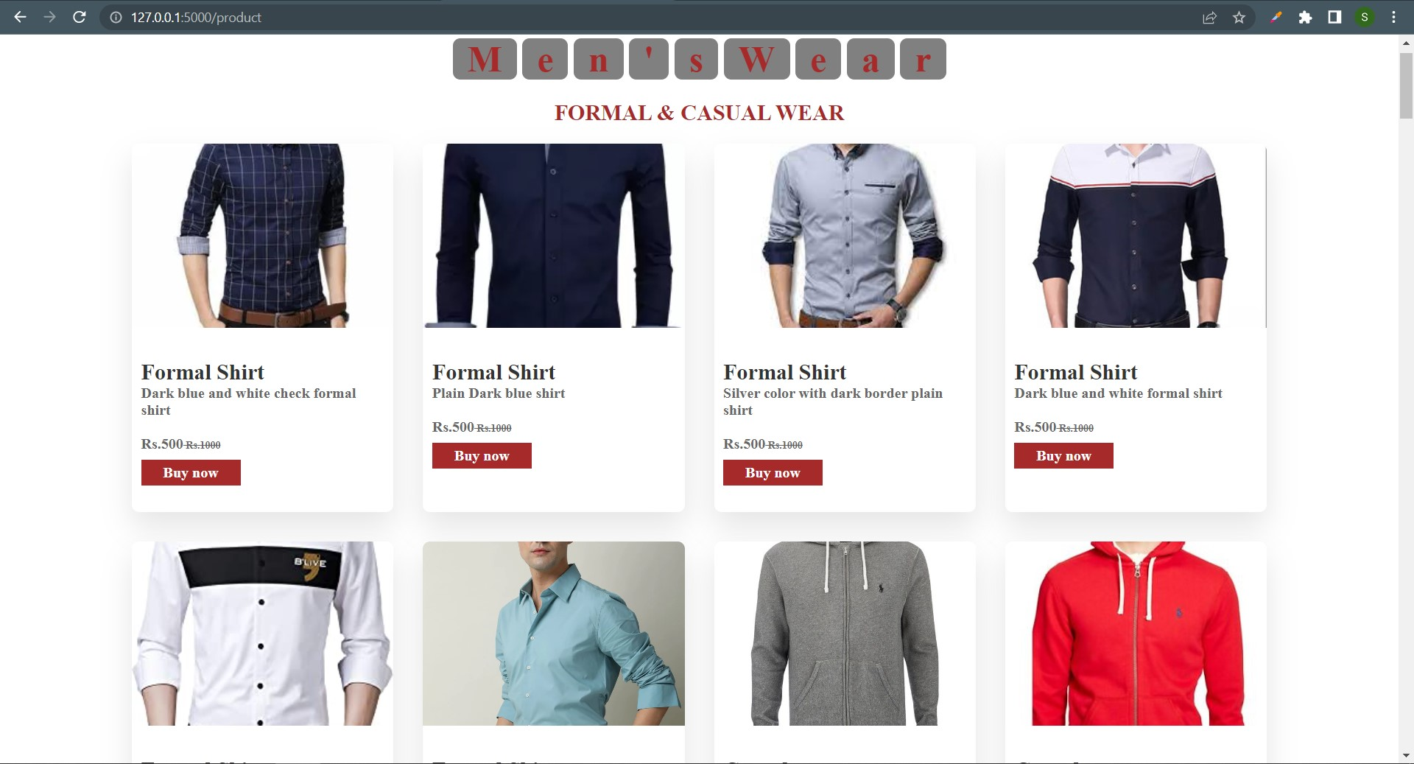
PROJECT PAGE

Slide 18
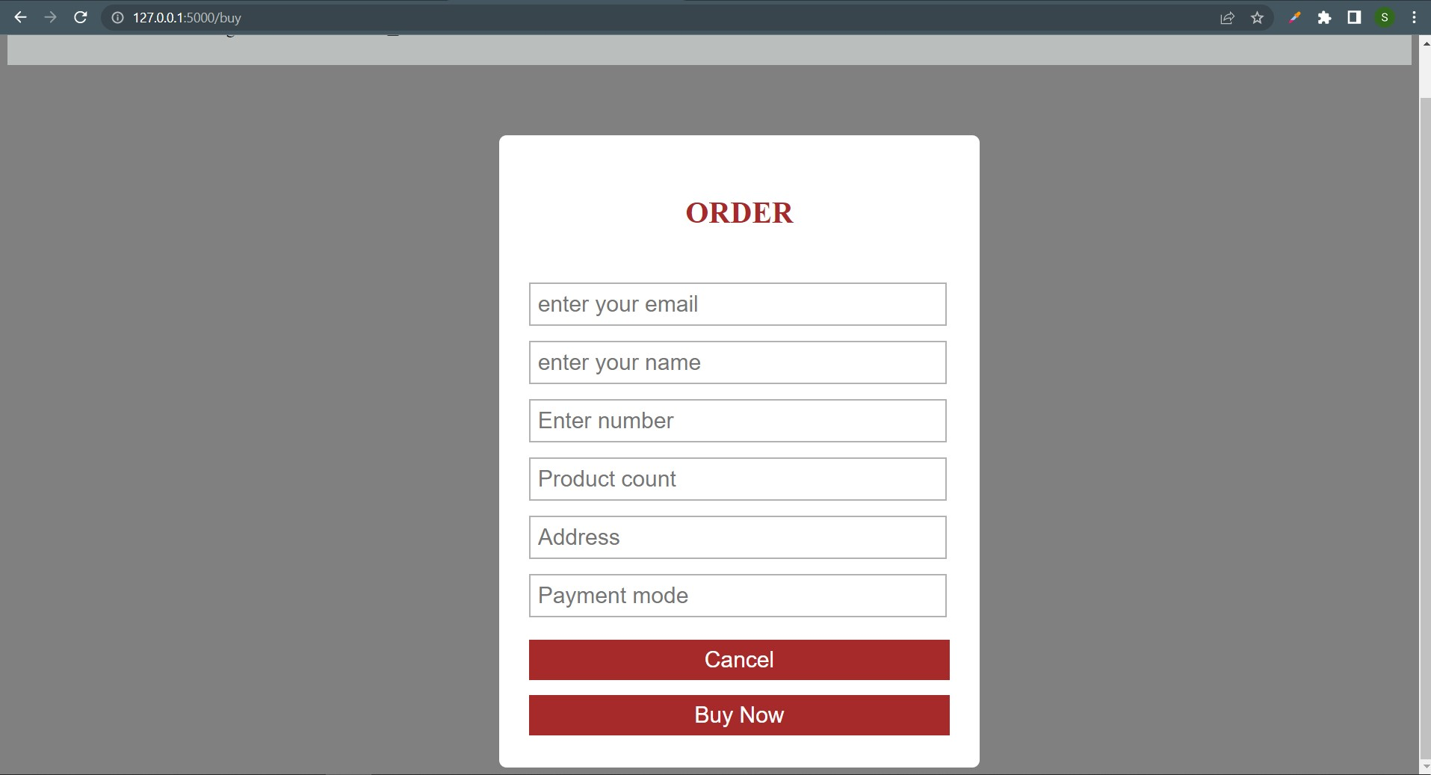
ORDER PAGE

Slide 19
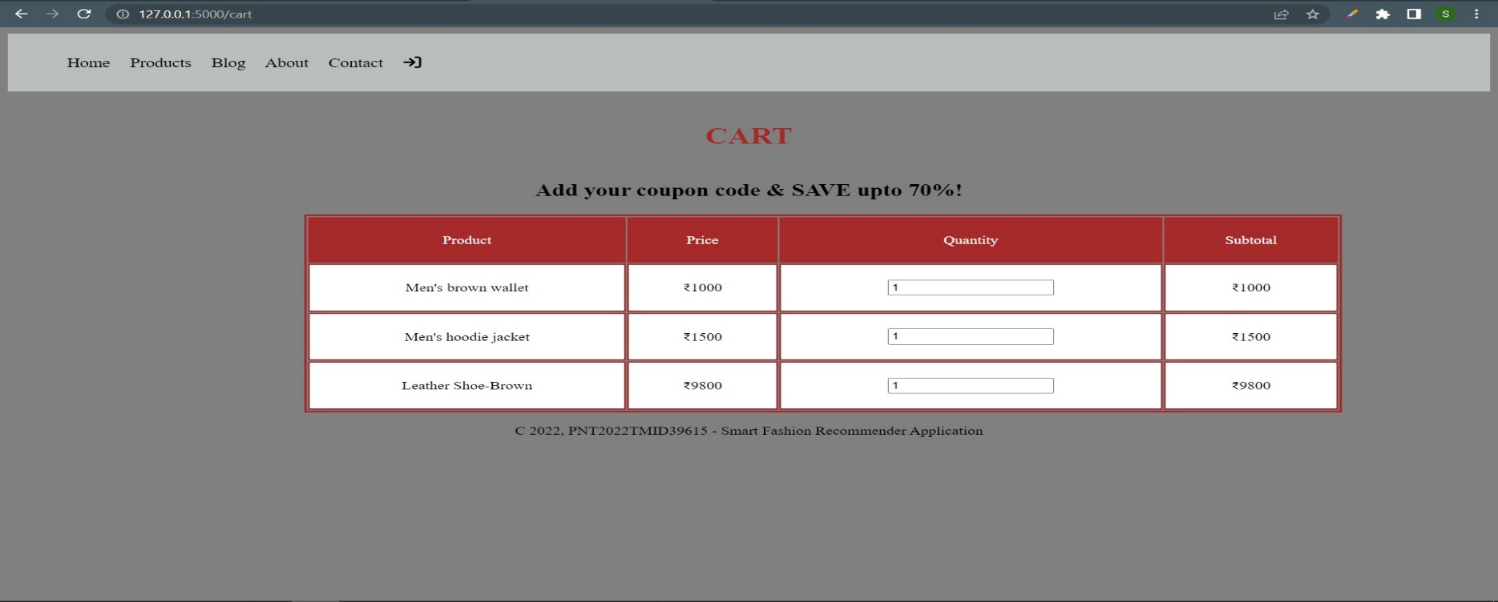
CART PAGE

Slide 20
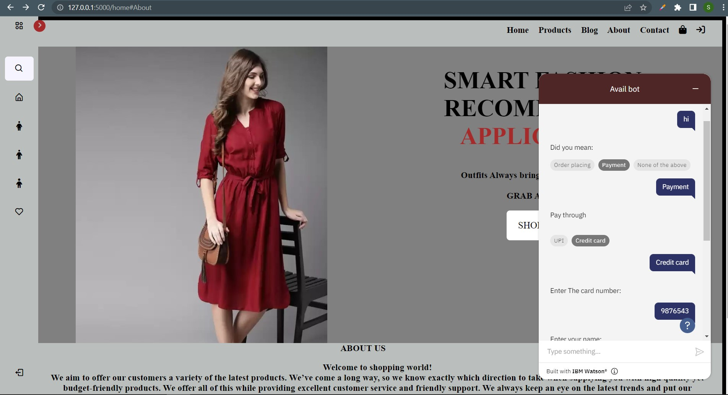
CHAT BOT

Slide 21
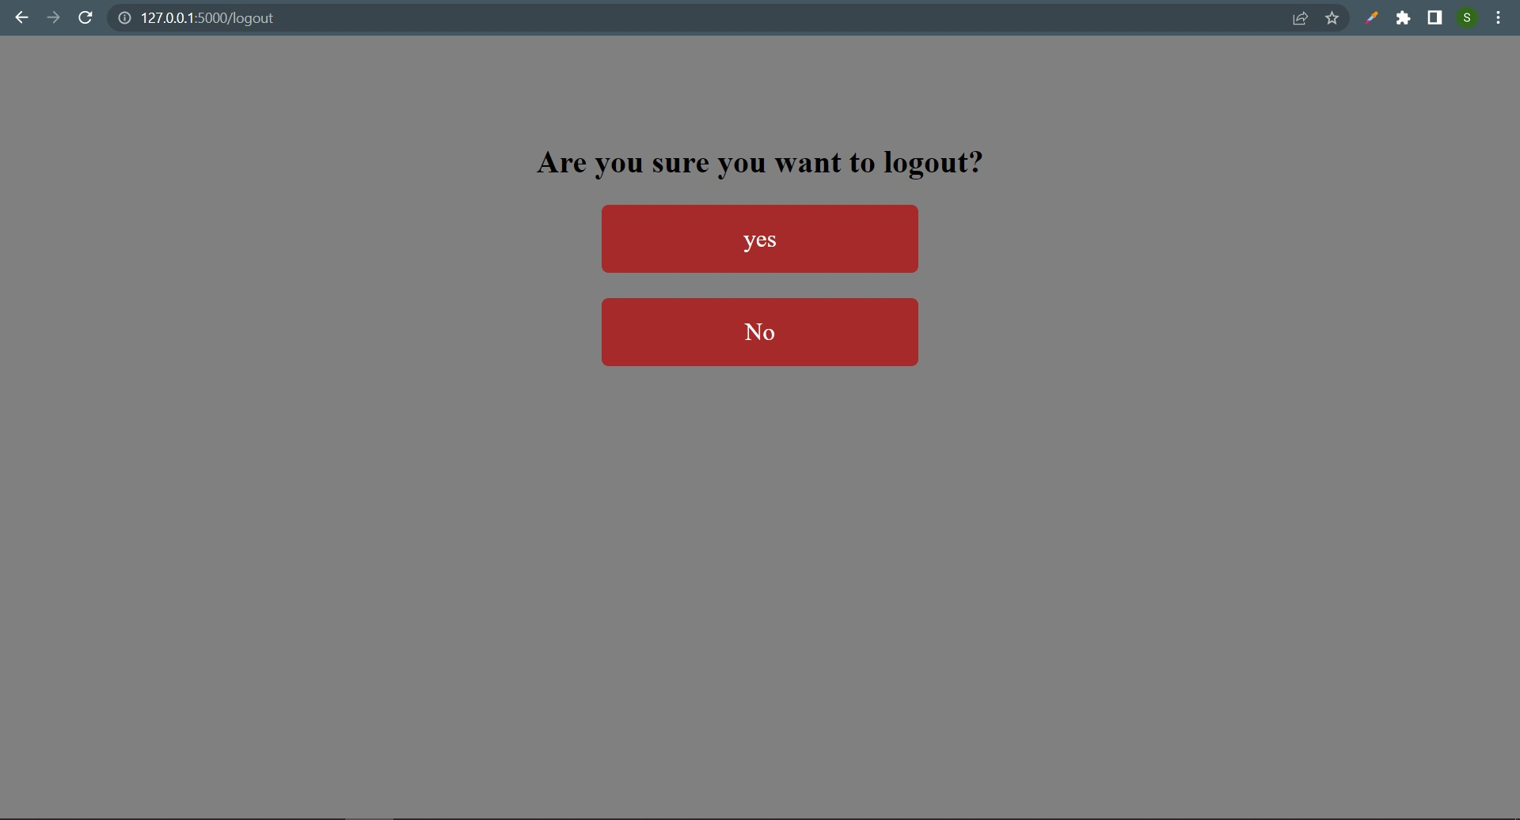
LOGOUT PAGE

Slide 22
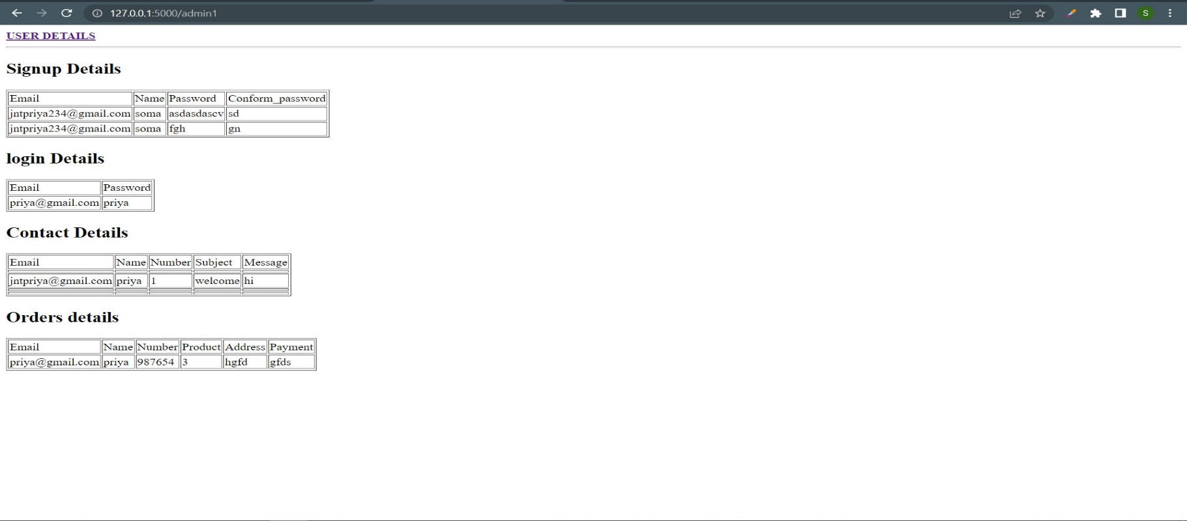
ADMIN PAGE

Slide 23
THANK YOU

